Slide 1

Cargo Shipping
Data Warehousing in Cargo Shipping

Slide 2

Introduction
Cargo shipping is the process of transporting goods from one location to another. It is a vital part of the global economy, as it allows for the movement of goods from one part of the world to another. Cargo shipping can be done by air, sea, or land, depending on the type of goods being transported and the distance involved.
Cargo shipping is a complex process, as it involves many different steps. It requires careful planning, coordination, and management in order to ensure that the goods are delivered safely and on time. Additionally, cargo shipping companies must ensure that the goods are properly packaged and labelled, and that all necessary paperwork is in order.

Slide 3

Why Data Warehousing in Cargo Shipping
Data warehousing is a valuable tool for cargo shipping companies, as it allows them to store, manage, and analyse large amounts of data quickly and efficiently. This data can be used to track shipments, identify trends, and improve customer service. By leveraging data warehousing, cargo shipping companies can gain a competitive edge and maximize their profits.
Data warehousing also helps cargo shipping companies to identify areas for improvement. By analysing data, companies can identify areas where they can reduce costs, improve efficiency, and increase customer satisfaction. Additionally, data warehousing can help companies to develop new products and services, as well as to identify new markets and opportunities.

Slide 4

Process of Cargo Shipping in DW
The process of cargo shipping in data warehousing involves several steps. First, the data is collected from the source systems. Then, the data is packed and loaded onto the cargo ship. The cargo ship then transports the data to the destination system. Finally, the data is unloaded and unpacked, ready to be used.
The process of cargo shipping is designed to ensure that the data is secure and accurate. The cargo ship is equipped with sophisticated security measures to protect the data from unauthorized access. Additionally, the data is monitored and tracked during the entire process to ensure its accuracy.

Slide 5
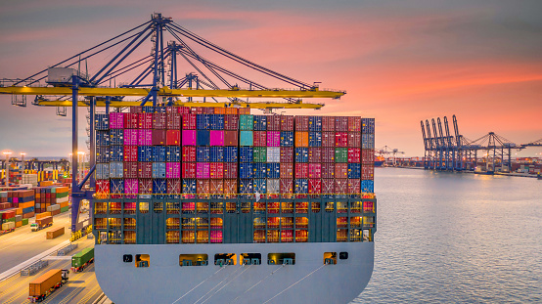
Data Warehousing and Cargo Shipping Benefits
Data warehousing and cargo shipping offer many benefits to businesses. By combining the two processes, businesses can save time and money. Data warehousing helps to store and manage data from multiple sources, while cargo shipping allows for the efficient delivery of goods. This combination of processes can help businesses to streamline their operations and improve efficiency.
In addition, the use of automated tracking, RFID tags, and GPS systems in cargo shipping helps to ensure that goods are delivered safely and on time. This helps businesses to reduce costs and improve customer satisfaction. The combination of data warehousing and cargo shipping can also help to reduce the risk of data loss and improve the security of data.

Slide 6

Tools and Technologies Used in DW
There are several tools and technologies used in cargo shipping in data warehousing. These include data compression tools, encryption algorithms, and secure data transfer protocols. Additionally, cargo ships are equipped with sophisticated tracking systems to ensure the accuracy and security of the data during the transfer.
Data warehouses also use advanced analytics tools to analyse the data and ensure its accuracy. Finally, data warehouses use backup and recovery systems to ensure that data is not lost during the transfer process.

Slide 7
What are fact and dimension tables
Fact and dimension tables are a key component of data warehousing. They are used to store, organize, and analyse data in a structured way. Fact tables store facts and measurements, while dimension tables store descriptive attributes related to the facts.
Fact and dimension tables are used to describe the data in a data warehouse and to provide a way of quickly and accurately retrieving data from the warehouse.

Slide 8
Fact Table Vs Dimension Table
Fact Table
Dimension Table
Fact tables are core components of data warehouses and are used to store large amounts of numerical data. In the context of cargo shipping, they are used to store information about each shipment, such as the weight, volume, and cost of the shipment.
Fact tables are typically organized by the dimensions of the shipment, such as the destination, the carrier, and the type of cargo. This allows for easier querying and analysis of the data.
Dimension tables are used to store information such as the names of shippers, receivers, and carriers, as well as other relevant data such as shipment dates, destinations, and goods being shipped. This data can then be used to analyse trends in cargo shipping and make decisions about future shipments.
Data warehousing allows for the efficient storage and retrieval of data in a structured form. Dimension tables are used to store data in a way that allows for easy access and analysis. This makes it easier to identify trends and make decisions about future shipments.

Slide 9
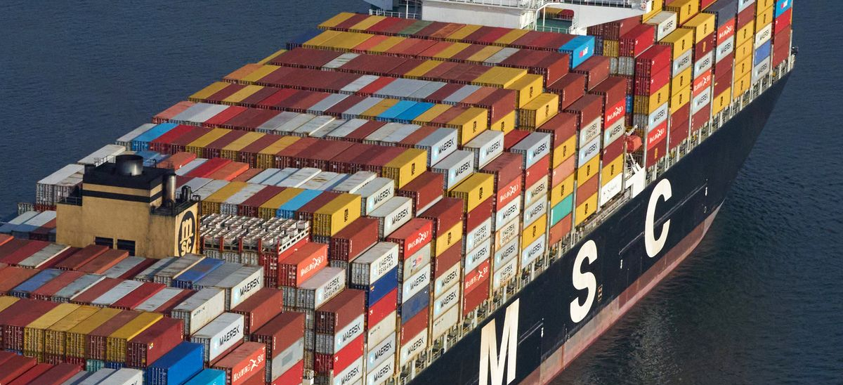
Mediterranean Shipping Company

Slide 10

Conclusion
Cargo shipping for data warehousing is a cost-effective and secure solution for businesses of all sizes. With the help of MSC, customers can quickly and easily set up their data warehouses and begin taking advantage of the benefits of cargo shipping. MSC is committed to providing the highest quality of service and security, making it the perfect choice for data warehousing and cargo shipping.
For businesses looking for a reliable and secure solution for data warehousing, MSC is the perfect choice. With a global network of offices and vessels, MSC is able to provide efficient and cost-effective solutions for data warehousing and other cargo shipping needs.

Slide 11
References
Data Warehousing Institute. (2020). What is Data Warehousing? Retrieved from https://www.dwinstitute.org/what-is-data-warehousing/
IBM. (2020). What is Cargo Shipping? Retrieved from https://www.ibm.com/support/knowledgecenter/en/SSZJPZ_11.5.0/com.ibm.swg.im.iis.ds.parjob.adref.doc/topics/r_cargoshipping.html

Slide 12
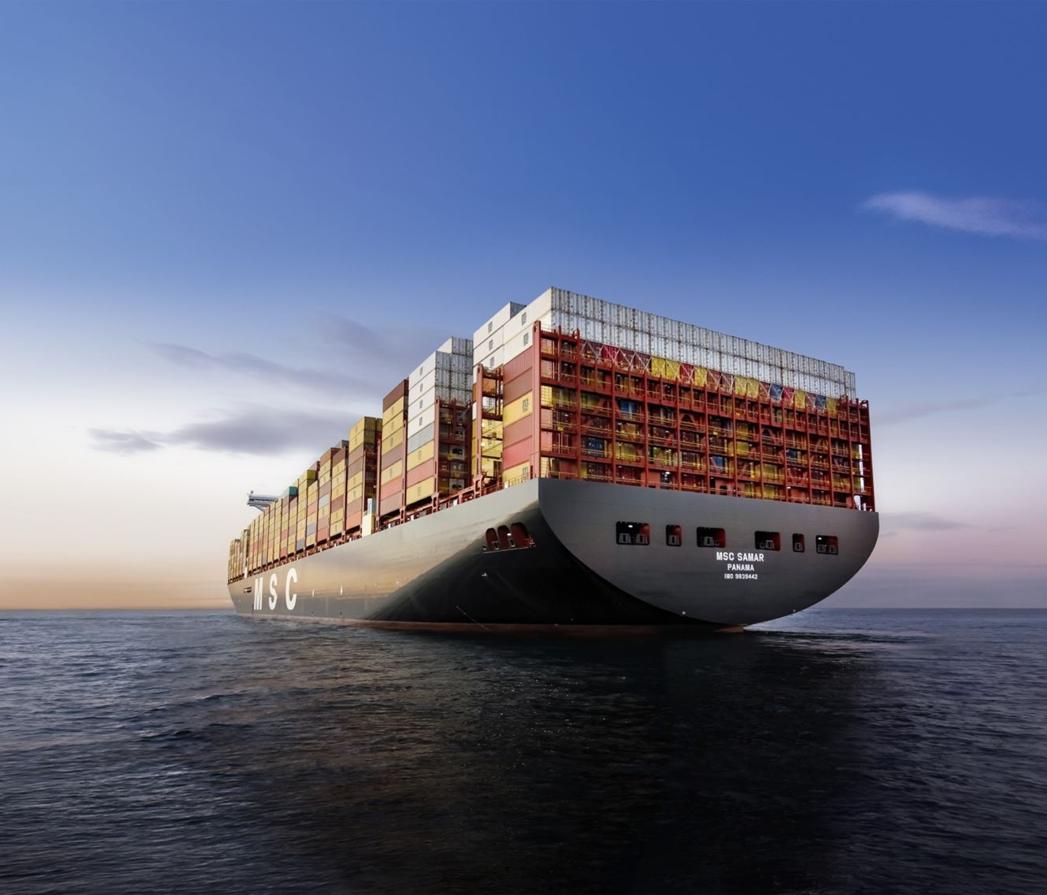
THANK YOU!
By Ayush Mehta and
Piyush Kumar

